Slide 1
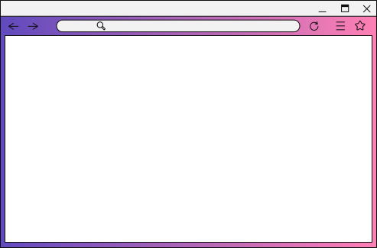

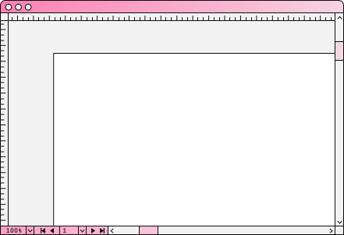


Messenger
Sản Phẩm Cuối Khóa
Được thực hiện bởi Việt Quang

Slide 2

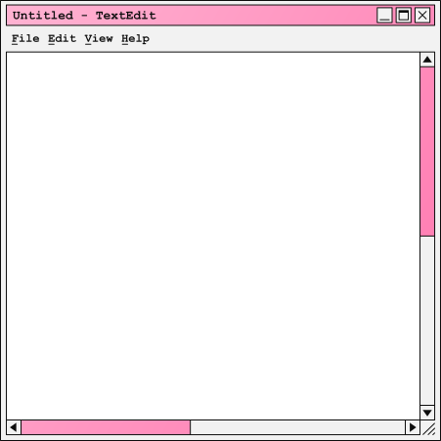
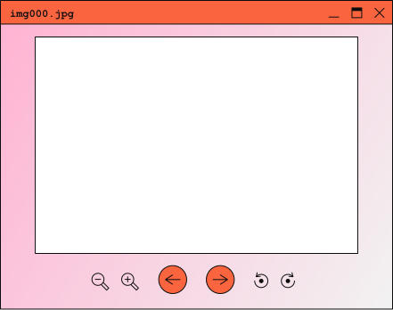

Mục lục
01 | Giới thiệu về bản thân
02 | Ý tưởng
03 | Lợi ích
04 | Quá trình
05 | Hướng dẫn sử dụng
06 | Cần cải thiện

Slide 3
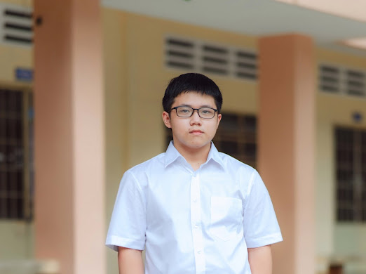
Giới thiệu về bản thân
Trương Việt Quang
Lớp JSI03 – Trung tâm MindX
Trang web em làm:

Slide 4
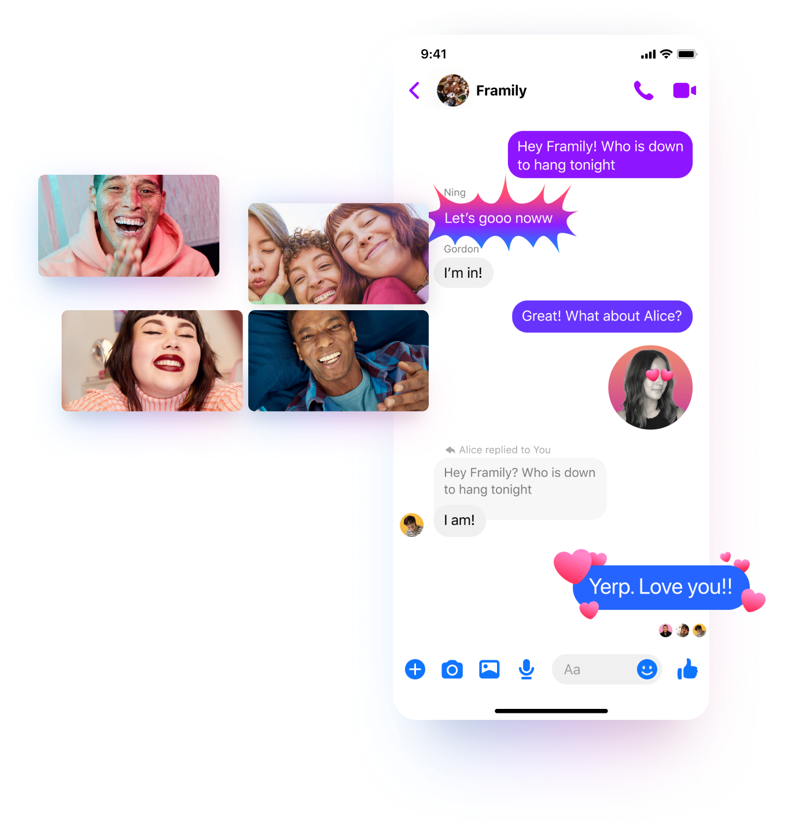
Ý tưởng
Sản phẩm này được xây dựng dựa trên trang Messenger.
Hiện nay, hầu hết các bạn trẻ đều đã có điện thoại của riêng mình. Vì thế hầu hết cách họ trò chuyện với nhau là thông qua những ứng dụng nhắn tin trên mạng. Thế nên em quyết định làm trang web này.

Slide 5
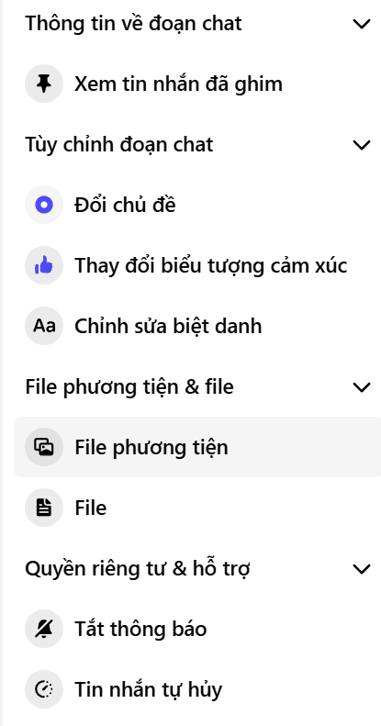
Lợi ích
Gửi tin nhắn không mất tiền
Gửi được nhiều thứ khác ngoài tin nhắn dạng văn bản như file word, các hình ảnh, video, các biểu cảm cảm xúc,…
Nhiều tính năng để làm đẹp cho đoạn chat, hạn chế cho một đoạn chat nào đấy,…

Slide 6
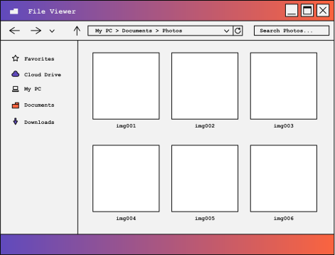
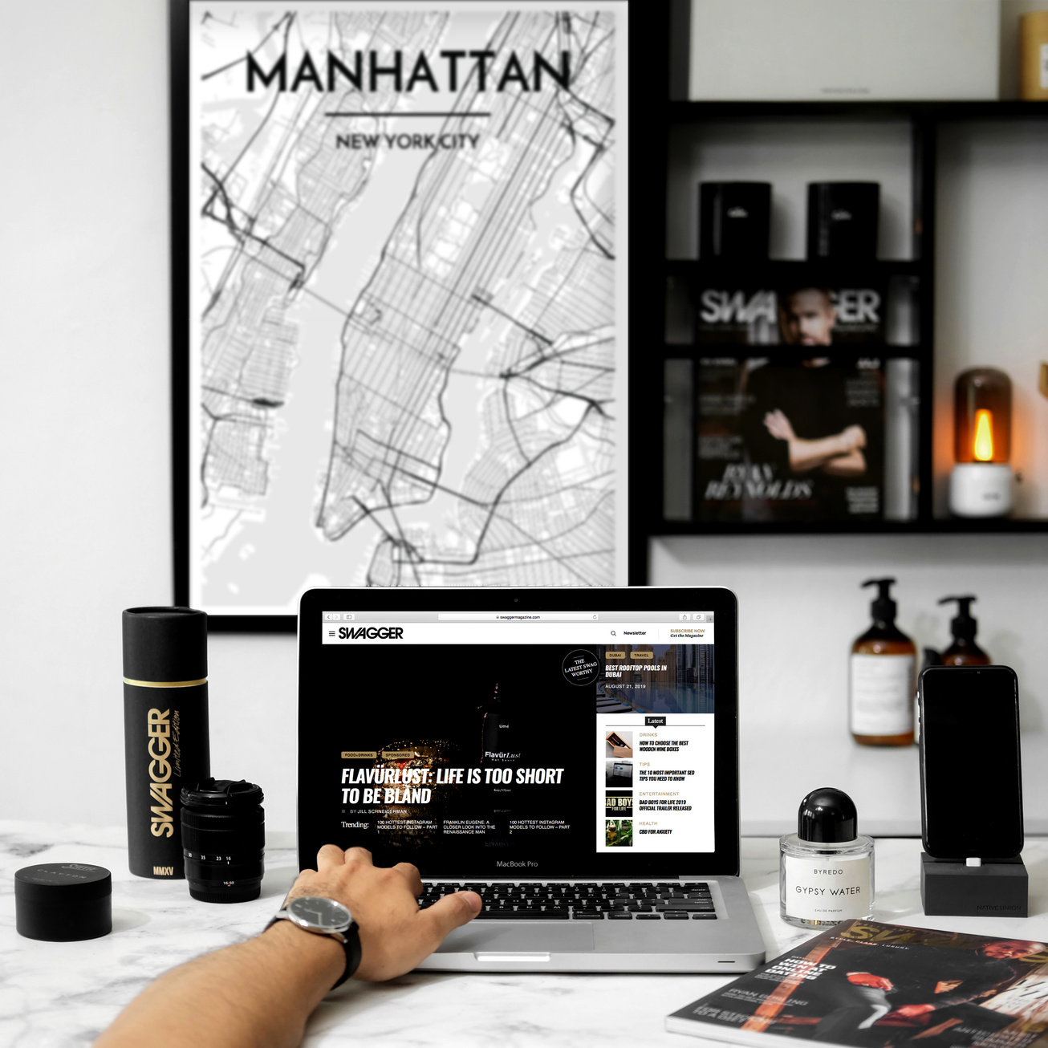

Web Design for
Keel and Briar
(JANUARY - MARCH 2019)
Drag and drop your photo or video! Click the sample photo or video and delete. Select yours from the uploads tab, drag, and then drop inside the frame!
In this project, I created the official website for start-up company Keel and Briar's launch.

Slide 7
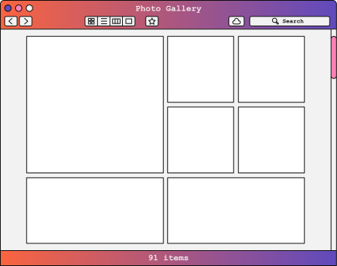
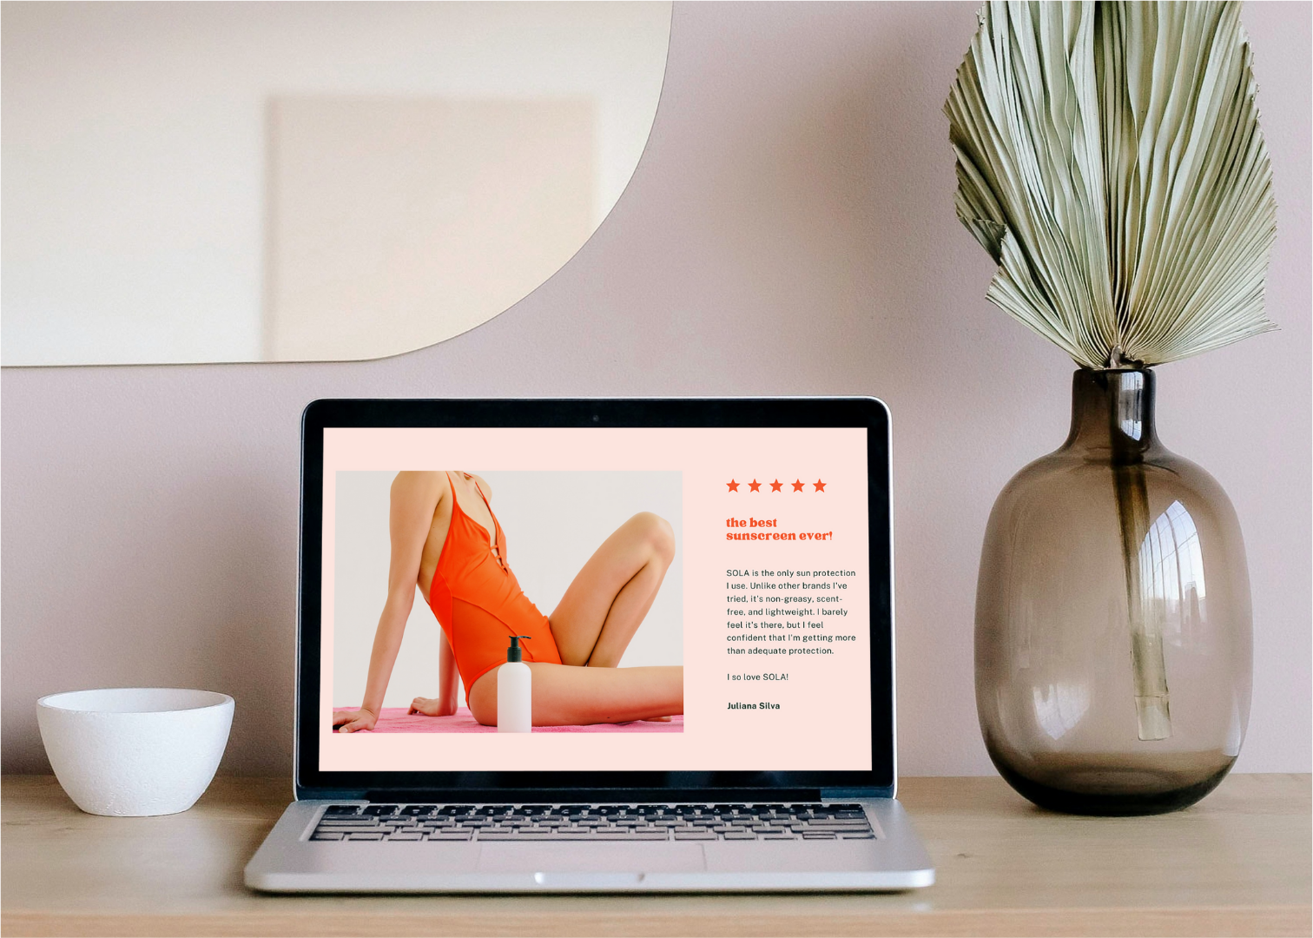

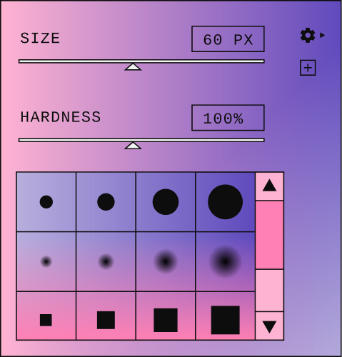

Campaign for
Skin Calm and Co.
(JULY - AUGUST 2019
I expanded the web pages for Skin Calm and Co.'s official website to match their growing company.

Slide 8
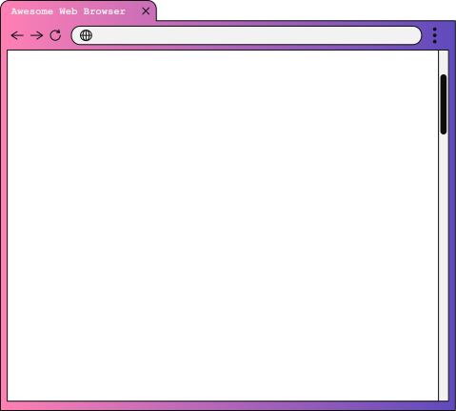
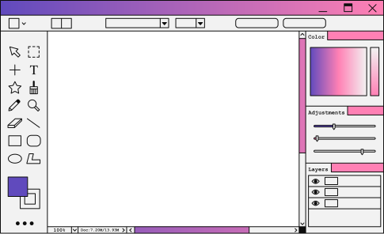
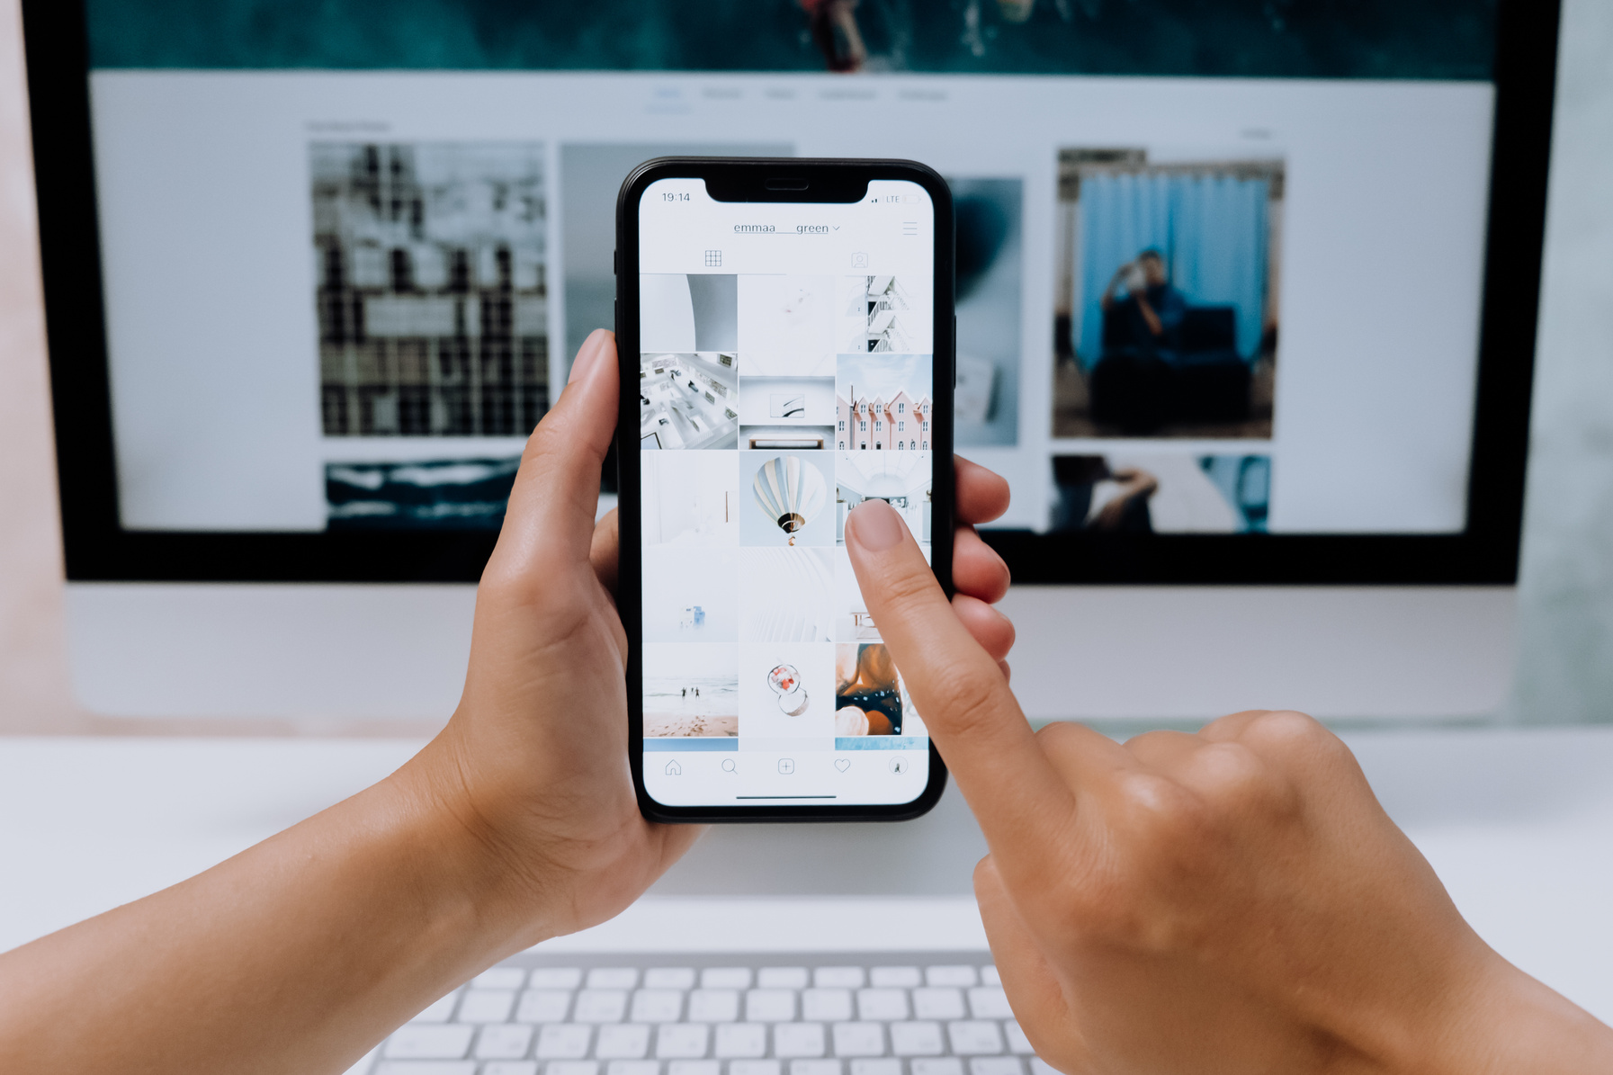
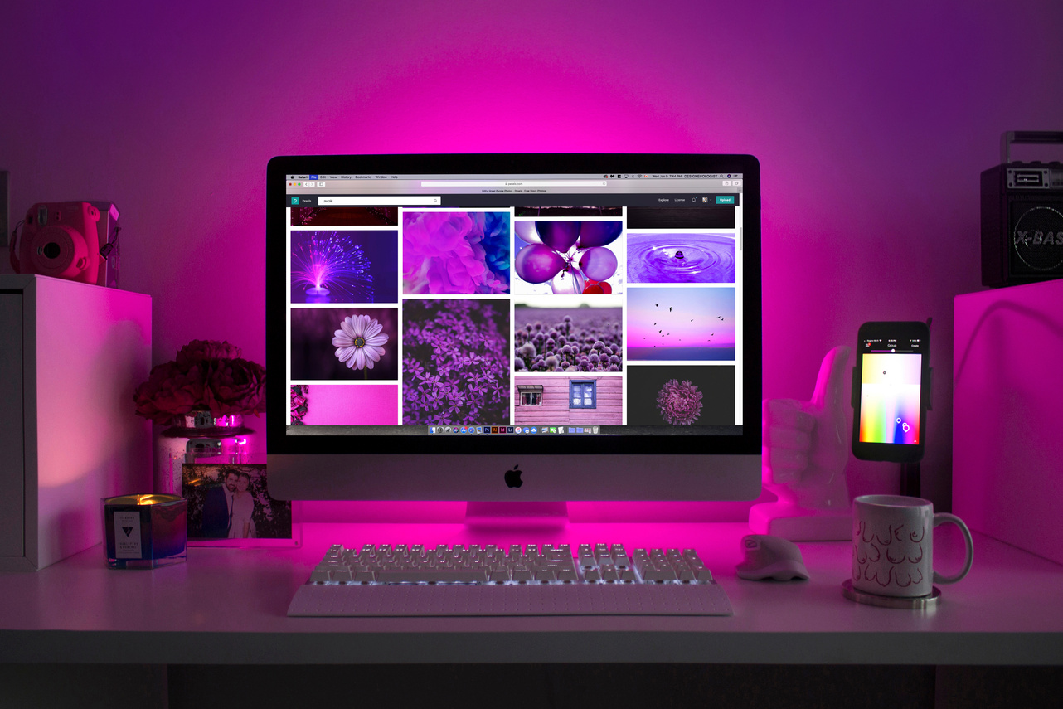
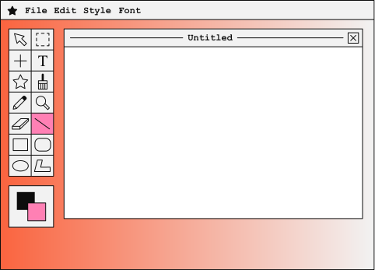
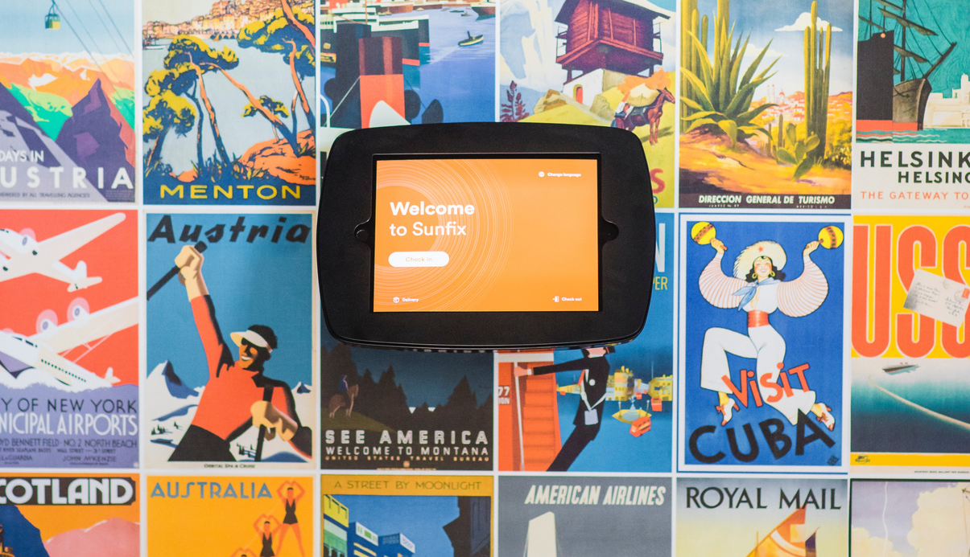
Web Design for
VZJ Co
(JUNE 2020)
I ramped up VZJ's website design to make it more dynamic and user-friendly.
Web Design for
The Plew
Web Design for
KNJ Label
(SEPTEMBER 2020)
I collaborated with the new company The Plew to build their first website.
(JULY 2020)
When KNJ Label rebranded, I helped to reflect that change in their website.
Back to Agenda Page

Slide 9

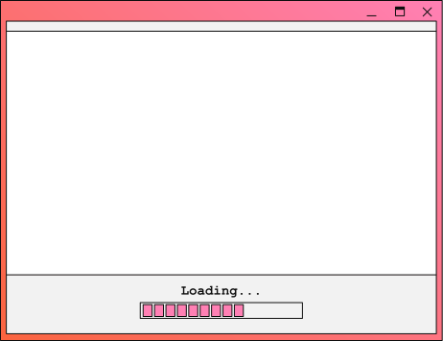
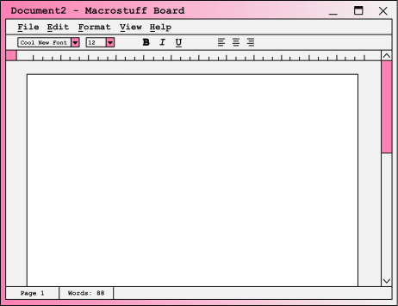
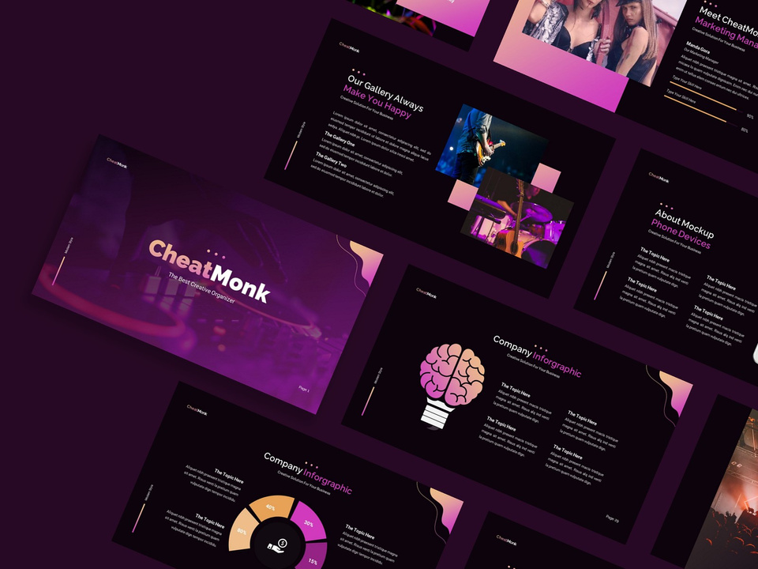


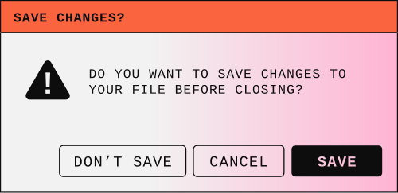
Responsive Web Design for Tawlley and Mauro
(JANUARY - JUNE 2021)
I collaborated with household name Tawlley and Mauro to give their website a fresher and up-to-date appearance.

Slide 10
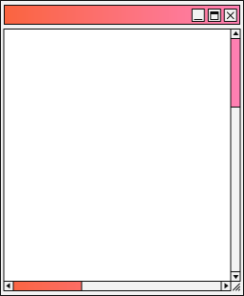


Project Rates
 | Plan A | Plan B | Plan C | Plan D
Package 1 | $ 000 | $ 000 | $ 000 | $ 000
Package 2
Package 3
Package 4
Highlight two or more cells, right-click then choose "Merge Cells" to organize your table according to your needs!
Back to Agenda Page

Slide 11

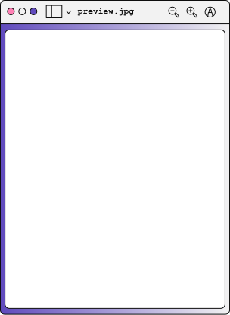
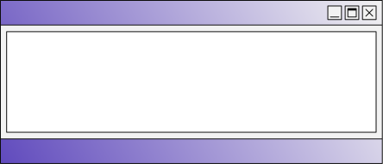

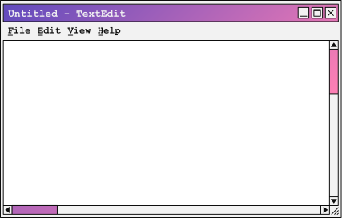
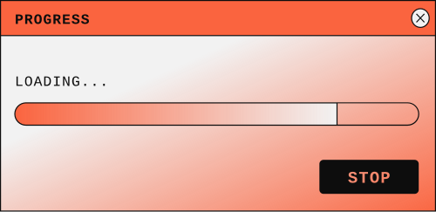
Client Testimonials
"A truly inspiring designer"
Mr. Hamilton's eye for design is incredible. He can highlight the beauty in simple things, a truly inspiring designer.
- TAWLLEY AND MAURO
"Highly capable and flexible"
Connor is very easy to collaborate with. He has a lot of good insights and is highly capable of meeting urgent demands!
- KEEL AND BRIAR
Back to Agenda Page

Slide 12
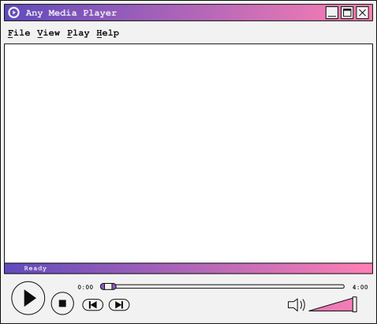



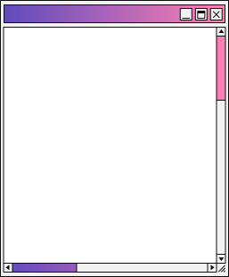

To see more of my work, visit my socials:
Your ideas and dreams deserve to be seen. Let's design them.
@reallygreatsite
Back to Agenda Page

Slide 13
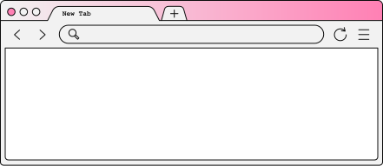

Work with me.
WEBSITE
www.reallygreatsite.com
EMAIL
hello@reallygreatsite.com
PHONE
123-456-7890

Slide 14
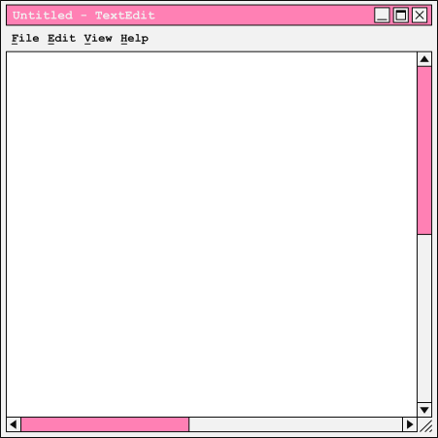
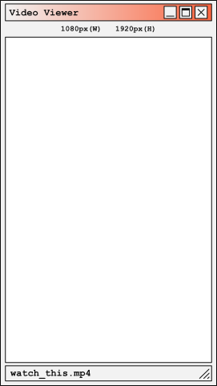

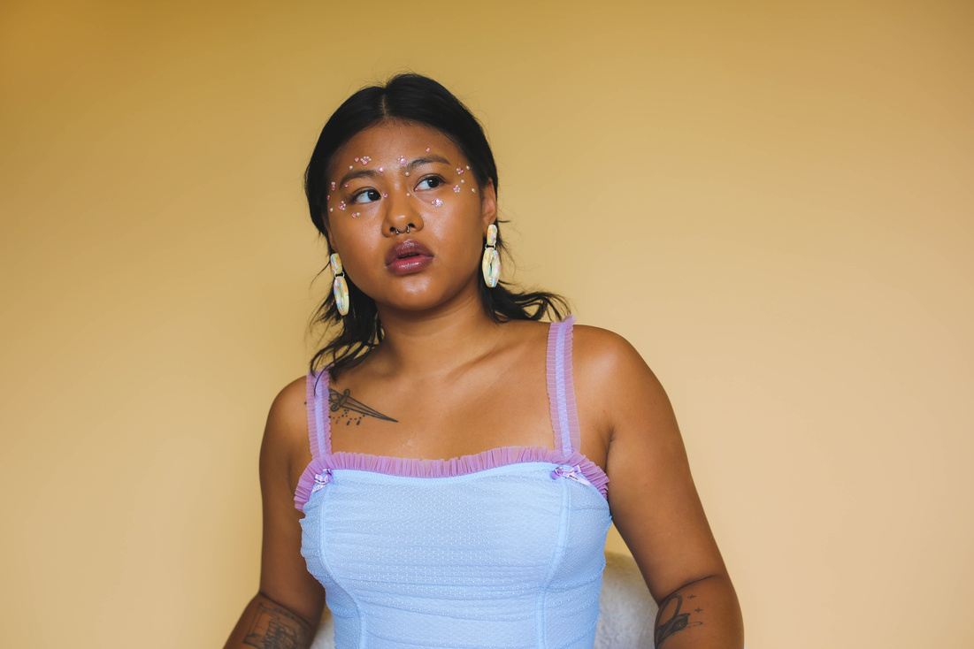

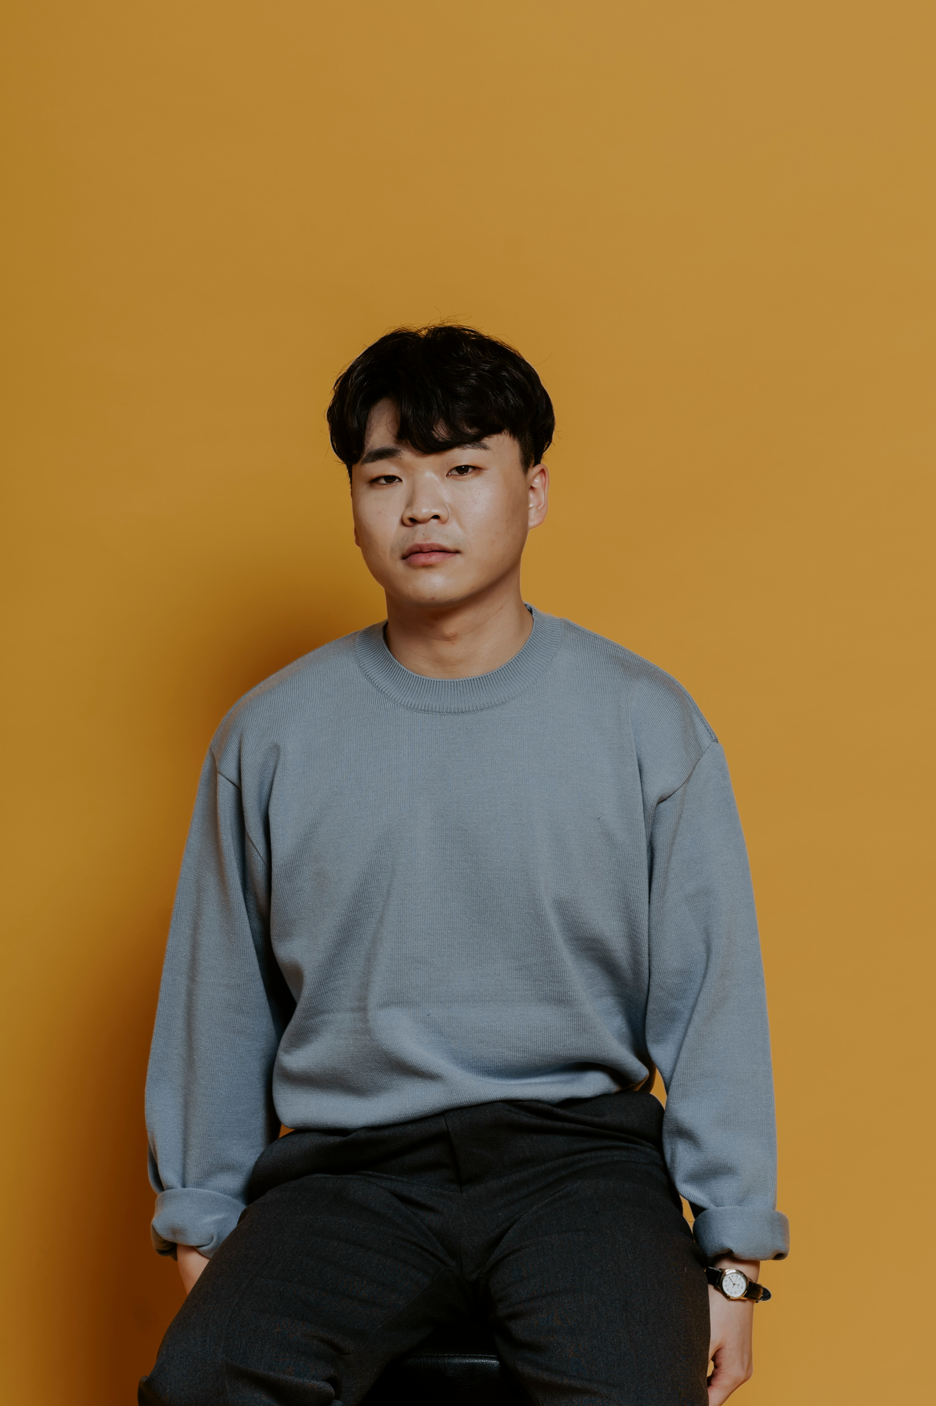
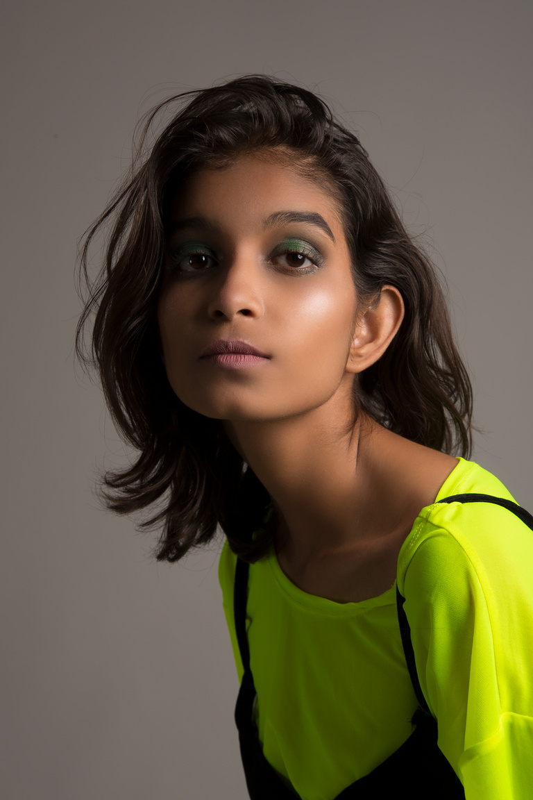
Collaborate on a Whiteboard
Copy a note, drag to the board, and write your ideas.
Write a note here
Write a note here
Copy a note, drag to the board, and write your ideas.
Tip: Collaboration makes teamwork easier! Click "Share" and invite your teammates to fill this up. Use this page for bulletins, brainstorms, and other fun team ideas.
Right-click on the background of the slide, or on the thumbnail below, for the option to expand this page into a whiteboard for more space!

Slide 15
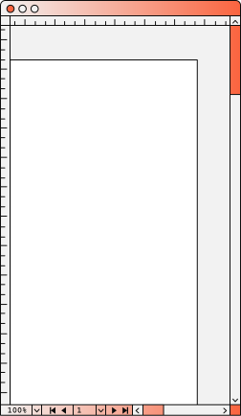
Add more sub-ideas
Add even more
sub-ideas
Add more sub-ideas
Add even more
sub-ideas
Add a related idea
Add a main topic
Collaborate on a Whiteboard
Add a related idea
Tip: Collaboration makes teamwork easier! Click "Share" and invite your teammates to fill this up. Use this page for bulletins, brainstorms, and other fun team ideas.
Right-click on the background of the slide, or on the thumbnail below, for the option to expand this page into a whiteboard for more space!
Add a related idea
Add a related idea
Add more sub-ideas
Add more sub-ideas
Add even more
sub-ideas
Add even more
sub-ideas

Slide 16
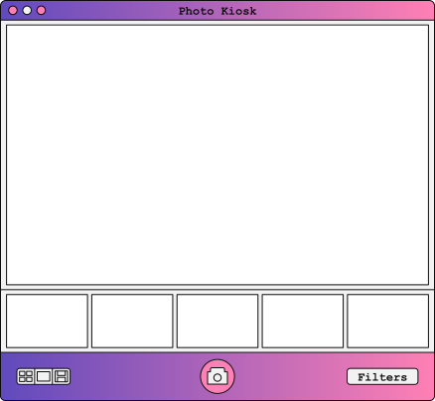
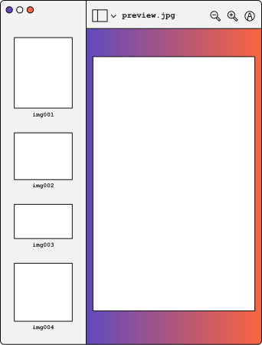
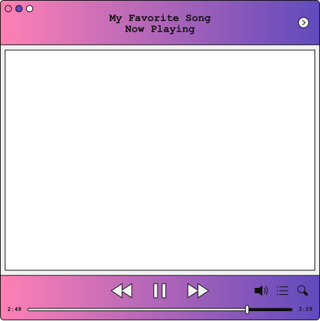
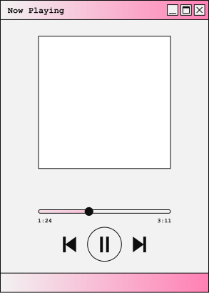
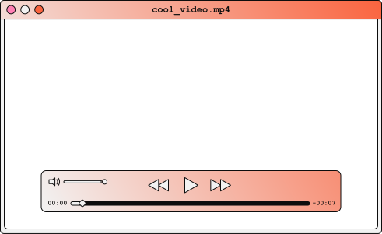
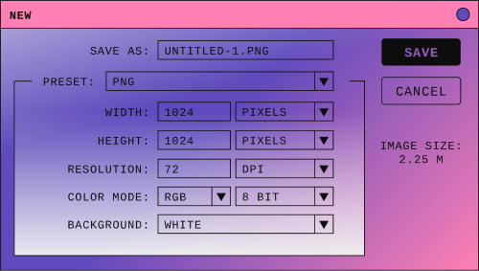
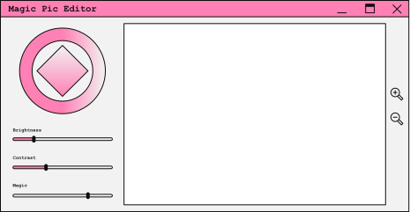
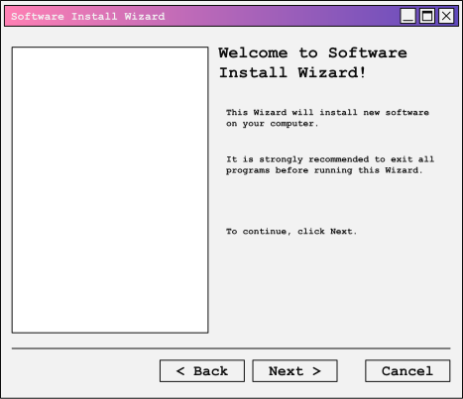
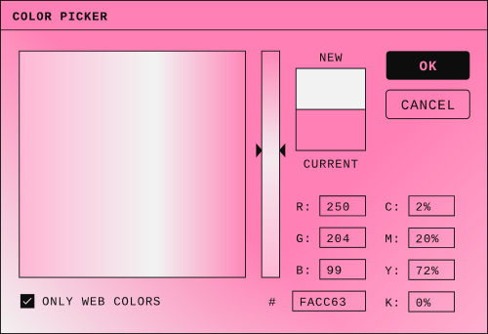
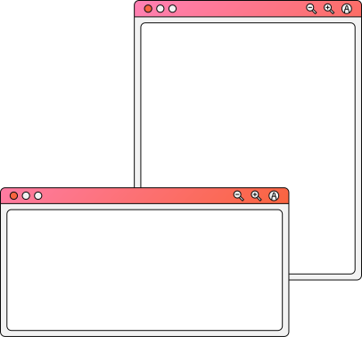
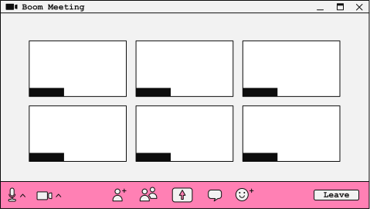
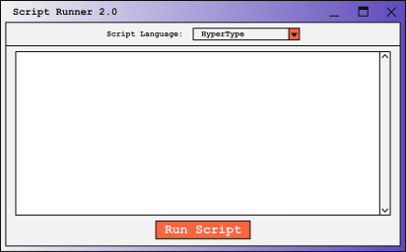
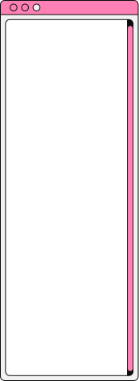
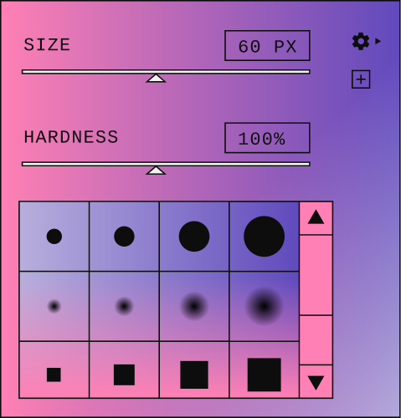



Resource
Page
Use these design resources
in your Canva Presentation.
Happy designing!
Don't forget to delete or hide this page before presenting.

Slide 17













Resource
Page
Use these design resources
in your Canva Presentation.
Happy designing!
Don't forget to delete or hide this page before presenting.

Slide 18
Resource Page
Find the magic and fun in presenting with Canva Presentations. Press the following keys while on Present mode!
Delete or hide this page before presenting.
B for blur
C for confetti
D for a drumroll
M for mic drop
O for bubbles
Q for quiet
U for unveil
Any number from 0-9 for a timer

